Slide 1

Control Panel & Task Manager
Presented To:
Rowzatul Zannat
Lecturer
Department Of CSE
Presented By:
Nurjahan Akther Mim 221-15-4782
Abu Zahed 221-15-4716
Md Amir Hamja 221-15-4784
Arnub Datta 221-15-4726
Fatema Akter Priya 221-15-4765

Slide 2

Control Panel & Task Manager
A Control Panel and Task Manager System is a tool that helps users manage their computer’s settings, programs, and performance. The Control Panel lets users adjust settings like sound, display, and network, while the Task Manager shows running programs and their resource usage. Users can stop unwanted programs and check system performance with simple graphs. It’s a useful way to keep a computer running smoothly.

Slide 3
Features
Task Manager
System Management
Network Managment
System details
Power Management
System Security

Slide 4

Used tools
Tkinter
Psutil
Alsaaudio
Os
Platform
File Handling

Slide 5
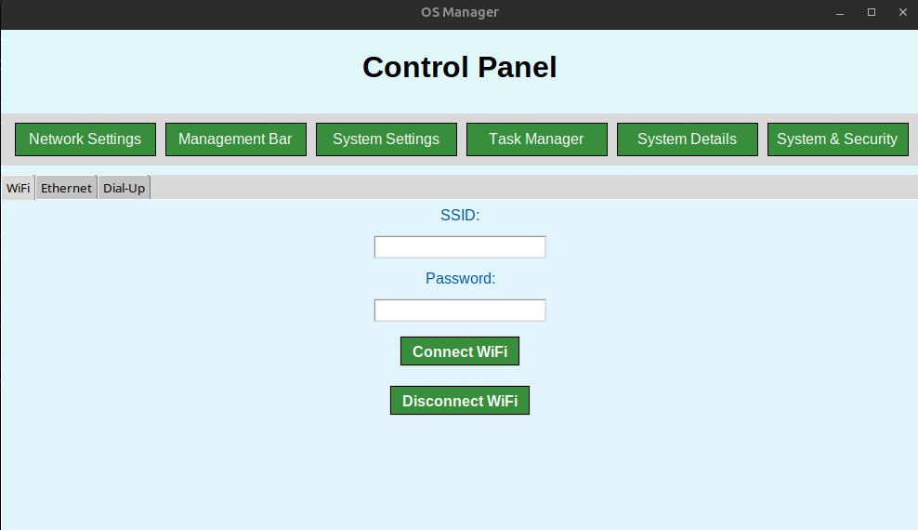
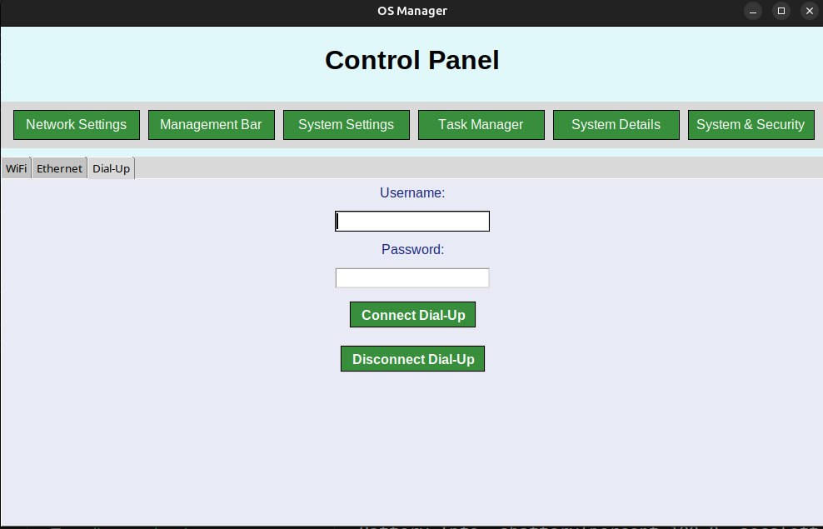
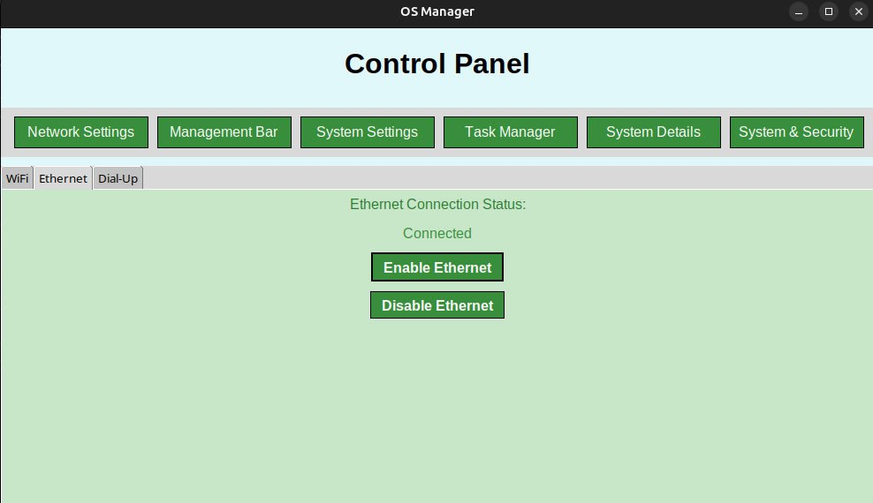
Network Management

Slide 6
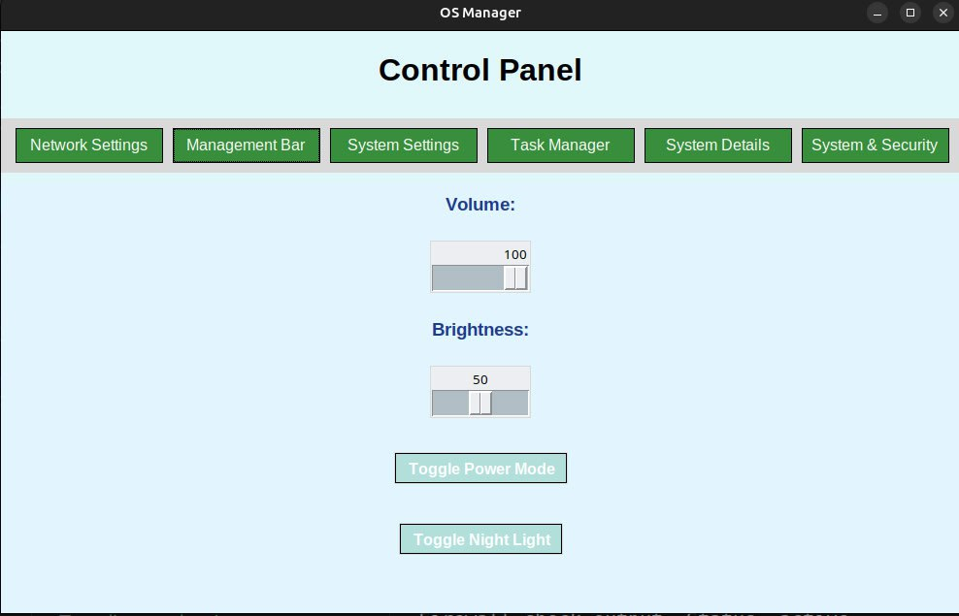
Management Bar

Slide 7
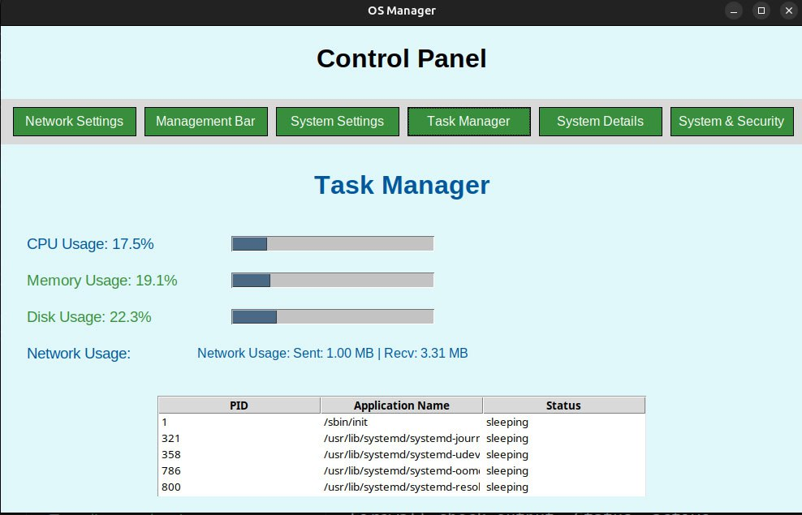
Task Manager

Slide 8
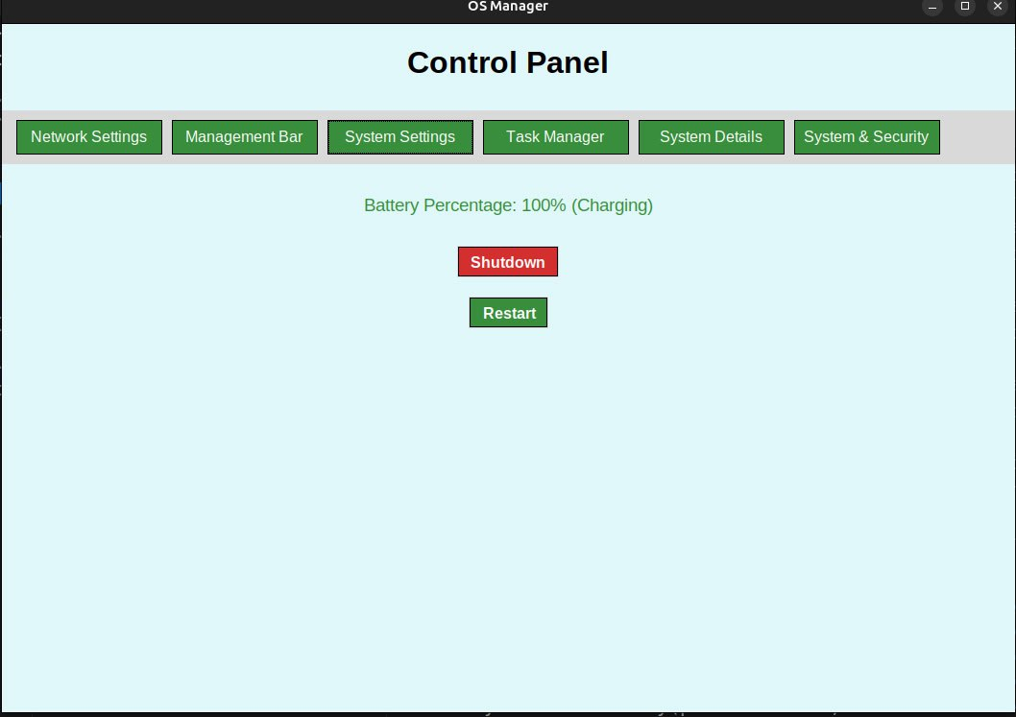
System Setting

Slide 9
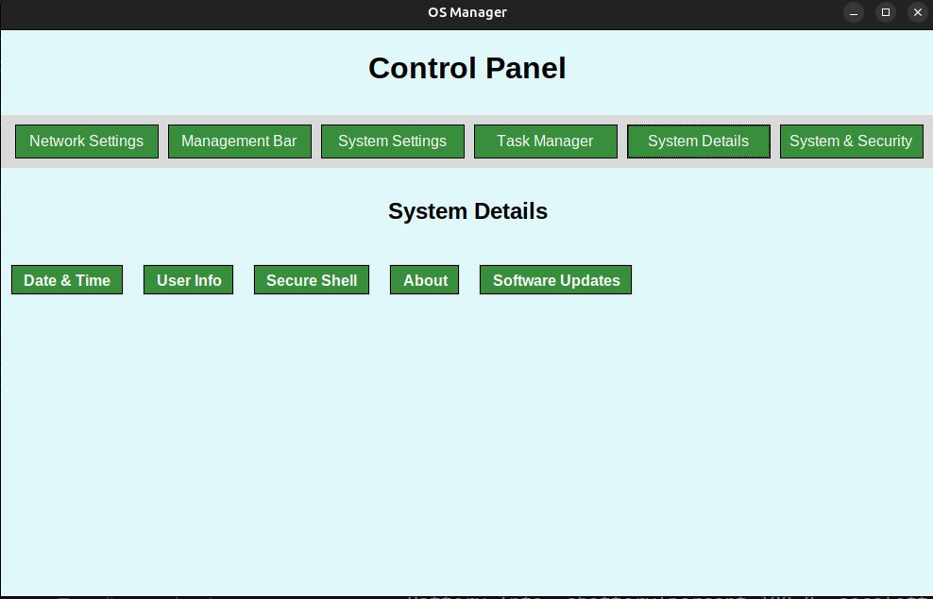
System Details

Slide 10
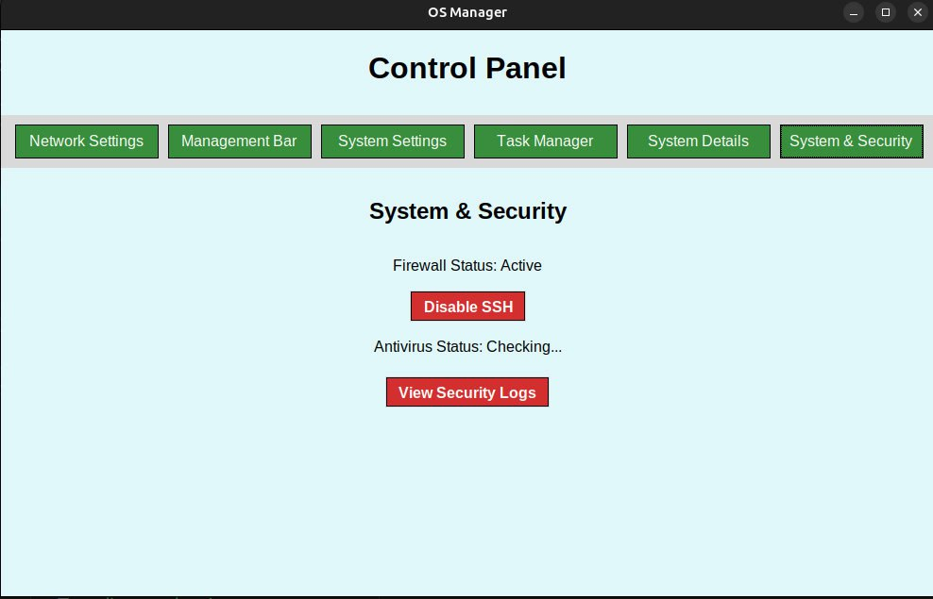
System & Security

Slide 11
Benefits
Centralized Control: Combines multiple essential tools like network settings, system monitoring, and power management into one interface for user convenience.
Improved Efficiency: Simplifies tasks like managing processes, monitoring system performance, and adjusting power settings, saving users time and effort.
Enhanced Security: Helps protect the system with features like user account management and activity monitoring, ensuring safe usage.
Real-Time Monitoring: Allows users to view CPU, memory, and network usage in real-time, helping them detect and fix system issues quickly.
Wide Applicability: Can be used in personal computers, office systems, or even educational setups to manage resources and ensure smooth operation

Slide 12
Conclusion
The OS Control Panel and Task Manager System is a robust and practical solution designed to help users manage their system’s resources, settings, and security in real time. By integrating features like network settings, system monitoring, power management, and security controls into a single interface, this project provides an efficient way to keep systems optimized and secure. The real-time capabilities of the system, including continuous monitoring of CPU, memory, and network usage, ensure that users are always aware of their system's performance and can take immediate action when needed. As technology evolves, this system has the potential for further enhancements, such as AI-driven optimizations and remote management, making it an adaptable and valuable tool for users.

Slide 13
THANK YOU! 😀

